Slide 1
11th Annual Medical Directorate Awards
Professor Emma Watson, Executive Medical Director

Slide 2
2024 Award Highlights….
Nominations from across Scotland
Panel: Medical Schools, Directors of Medical Education, Foundation, General Practice, Trainees, Postgraduate Deans
All nominees will receive formal acknowledgement

Slide 3
2024 Awards…
Innovative Education and Technology
Equity, Diversity and Inclusion
Exceptional Staff Support
Inspirational Role Model

Slide 4
g
Award for Innovative Education and Technology
Notes:
The first Award is for Innovative Education and Technology
This award reflects the 2024 Conference theme and recognises the transformational power and potential that innovation and technology can bring to medical education.
Nominees may have piloted, developed and evaluated novel or cutting-edge educational interventions that draw on the latest technology, leading to positive impact and influence on the learning environment and educational outcomes.
The runner up is…

Slide 5
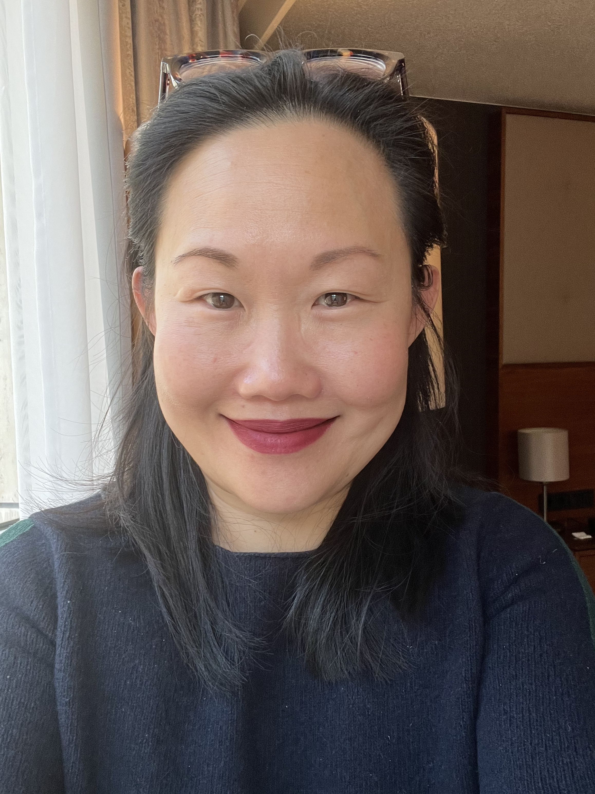
Runner Up
Professor Cindy Chew

Slide 6
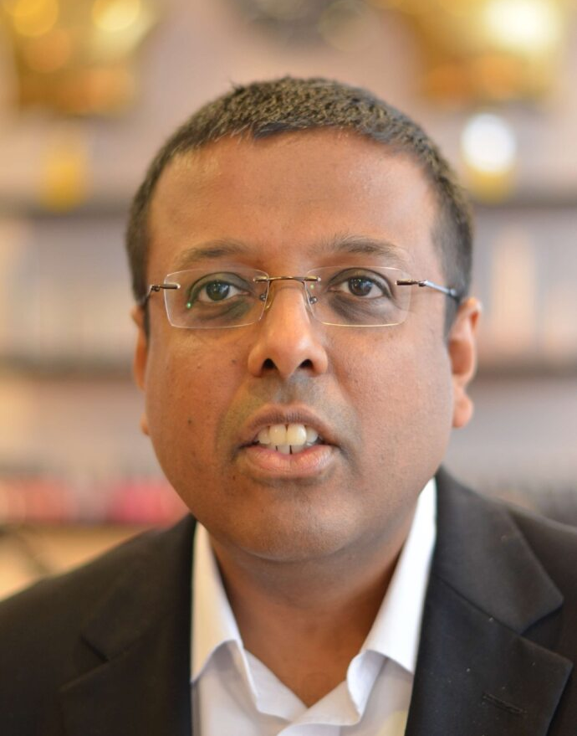
Winner – Innovative Education and Technology
Mr David Varghese

Slide 7
g
Award for Equity, Diversity and Inclusion

Slide 8
Runner Up
Dr Lynsay Crawford and Dr Katie Brown

Slide 9
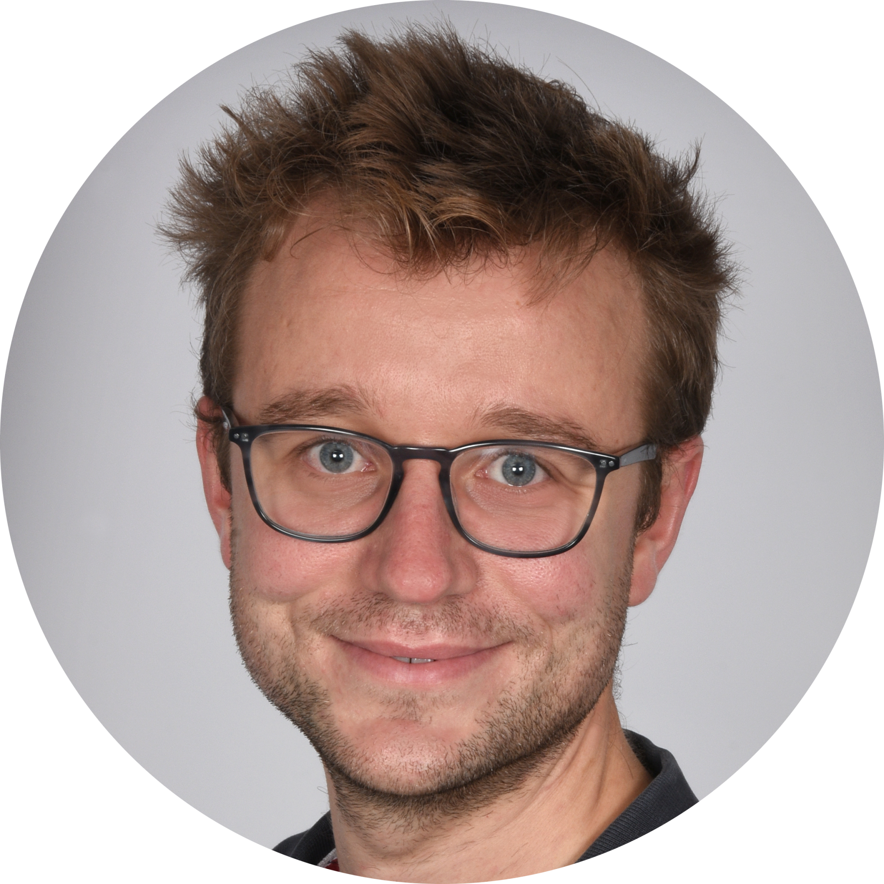
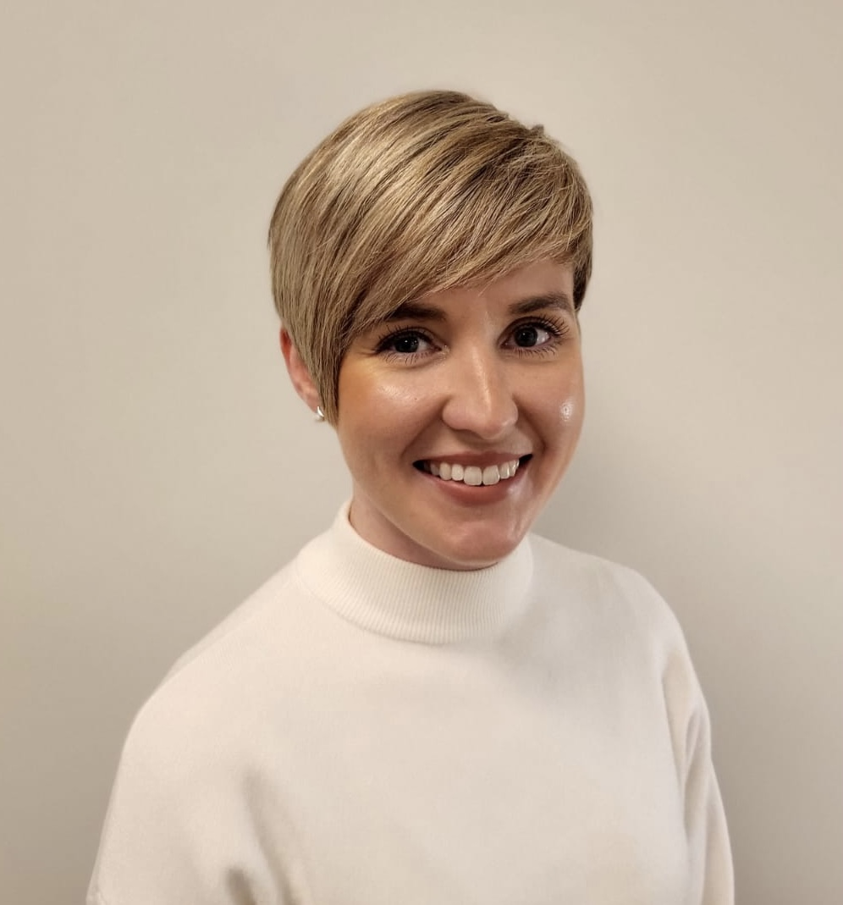
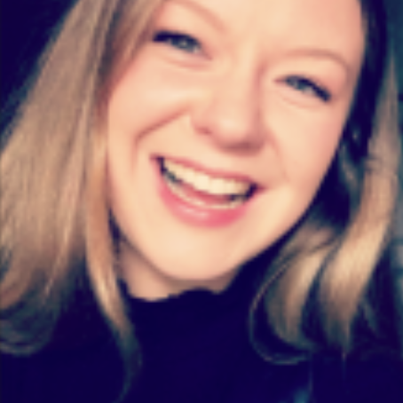
Winner – Equity, Diversity and Inclusion
Lothian MED Fellows

Slide 10
g
Award for Exceptional Staff Support
Notes:
This award recognises administrative and support staff who have gone beyond their roles to foster an inclusive and supportive educational/clinical environment. Nominees may have introduced initiatives or systems that not only improve educational/Clinical processes but also promote inclusivity and diversity at a local or regional level.
The runner up is….

Slide 11
Runner Up
Philip Smith

Slide 12
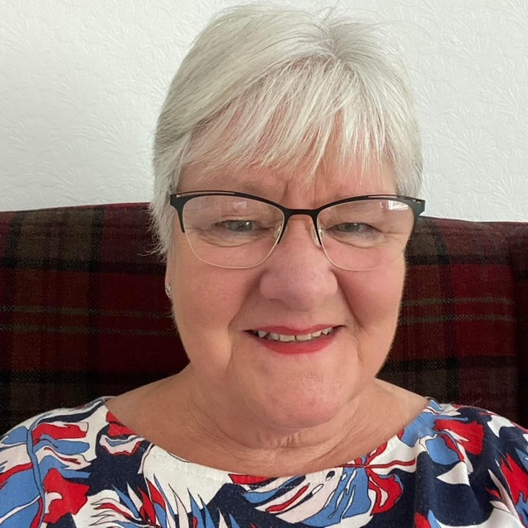
Joint Winner – Exceptional Staff Support
Marion Mackay

Slide 13
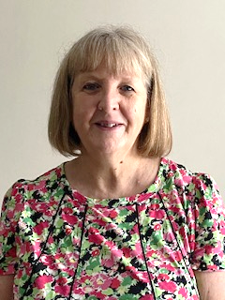
Joint Winner – Exceptional Staff Support
Angela Haining

Slide 14
g
Award for Outstanding Role Model

Slide 15
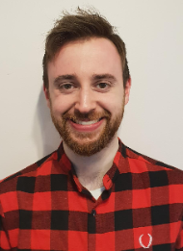
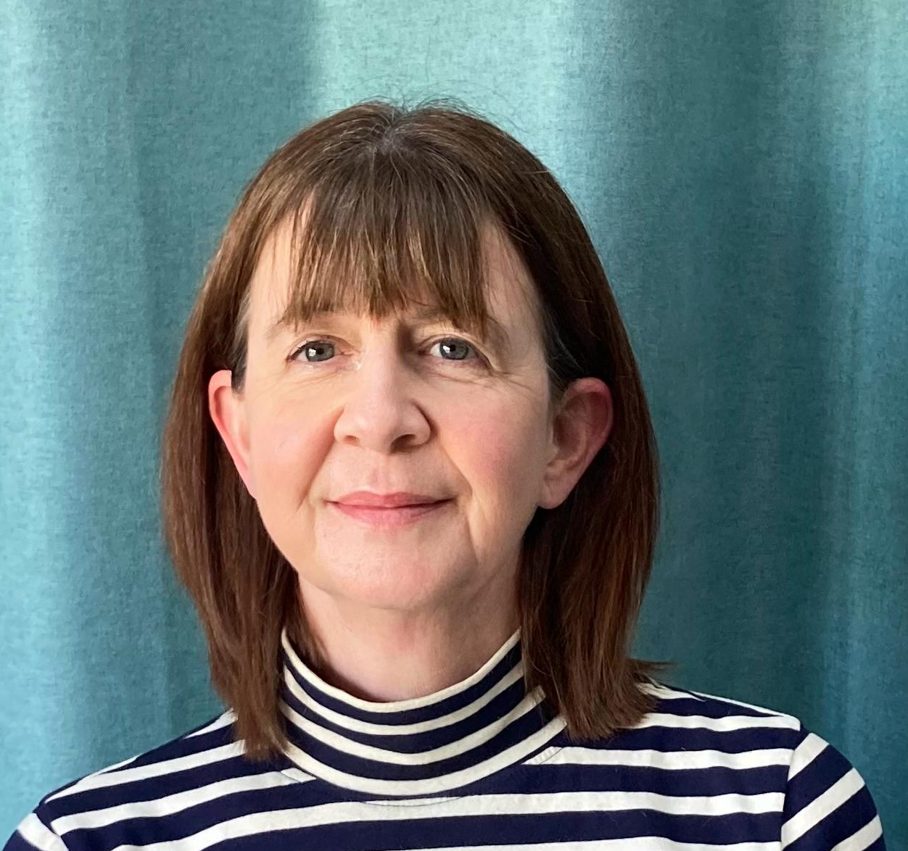
Joint Runners Up
Dr Wendy Corstorphine
Dr Dean O’Dwyer

Slide 16
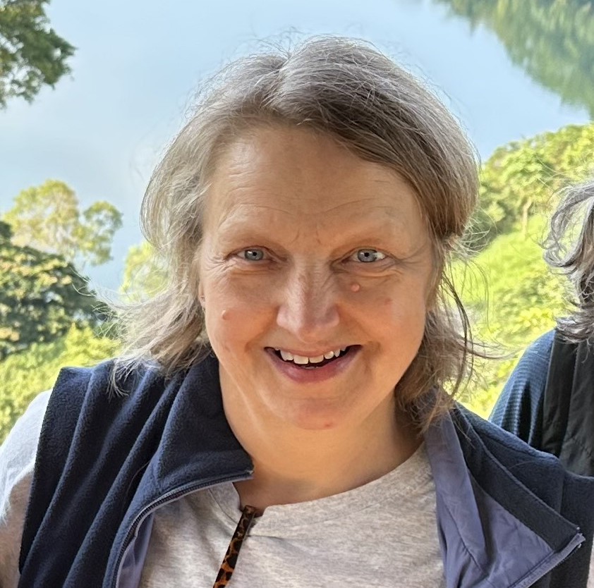
Winner – Outstanding Role Model
Professor Morwenna Wood

Slide 17
11th Annual Medical Directorate Awards
Professor Emma Watson, Executive Medical Director

